Slide 1
If you’re not able to run the workshop in a half-day, 4-hour workshop, you can run it in two, 2-hour workshops. You can space the two workshops out however it fits participants’ schedules–ideally between one day and one week apart.
If you’re doing this, be sure to use the following materials, specifically designed for two, 2-hour workshops.
Two, 2-Hour Moderator Guide
Two, 2-Hour Workshop Presentation
A note before you get started
Notes:
Before you share your screen:
Hello everyone! My name is [INSERT NAME], I use [INSERT PRONOUNS], and I’ll be facilitating this program at [INSERT COMPANY]
MODERATOR PERSONALIZATION: Share with the participants the following:
Why are you motivated to bring this to your organization?
Where is the company on their allyship journey? How does this fit into, or differ from, other allyship efforts?

Slide 2
WORKSHOP PRESENTATION
ONE 4-HOUR WORKSHOP
Notes:
With that, let’s dive in.
[Share screen]
Welcome to Lean In’s Allyship at Work!

Slide 3
Welcome!
Remove distractions
Get comfortable
Find a space where you can talk openly
Ground yourself
©2021 LeanIn.Org, LLC 3
Notes:
We’re so glad you’re here. During our time together, we invite you to:
Remove distractions—pause notifications on your phone and computer
Get comfortable—take a moment to get water, some note-taking things, and anything you need to be prepared for this time together
Find a space where you can talk openly—we’ll be in small group discussions throughout the workshop
Ground yourself—take a breath, and do what you need to do to feel present

Slide 4
1
2
3
4
5
6
7
Define allyship
Unpack your privilege
Uncover workplace inequities
Agenda
Discover your power
Learn allyship actions
Review the Active Allyship Framework
Introduce the follow-up sessions
©2021 LeanIn.Org, LLC 4
Notes:
This workshop will run for four hours
Like we are now, we’ll be on [insert video conferencing software] for both sessions, and you will use a Personal Workbook for all workshop activities. [Co-moderator] is going to drop a link into the chat for you to access the workbook on your own computers, if you haven’t already. Throughout the workshop, we’ll let you know when to switch to the workbook.
The workbook is stored locally on your computer so your responses are private and only you have access to them
Your responses will save even if you close the link, but during the duration of the program, both the workshop and follow-up sessions, do not clear your cache on your internet browser
Finally, you can navigate the workbook a few different ways:
Tap the arrows on the left and right side of the page,
Use the navigation bar on the left
Or type the page number in the “Go to page” box.
[Drop this link into the chat: leanin.org/participant Pause for a few moments while participants access their Participant Workbook]
The first half of this workshop, we’re going to focus on developing a shared understanding of allyship. So we’ll learn about:
What allyship is—and isn’t
Unpacking our personal privilege in and outside of work
Learning about the inequities that impact people with less privilege at work
During the second half, we’ll jumpstart your allyship journey by
Discovering what power we have to enact change at work
Learning specific actions to practice allyship
Closing by reviewing the Active Allyship Framework—a framework that we’ll explore throughout the program and that you’ll use in the follow-up sessions.
In your follow-up sessions, you’ll continue meeting with your small group to explore new allyship strategies and practice filling out your own Active Allyship Framework

Slide 5
DROP IN THE CHAT
What motivates you to learn about or practice allyship?
©2021 LeanIn.Org, LLC 5
Notes:
So to get us going, I’d like to invite you to drop in the chat what motivates you to learn about or practice allyship.
There’s no right answer – everyone comes to the table with different ideas and motivations for practicing allyship.
[Pause a few moments to let participants put answers in the chat. Then, read out a few examples]

Slide 6
WHY I’M HERE
©2021 LeanIn.Org, LLC 6
Notes:
An important part of allyship is doing the work to understand our privileges, our intentions, and our role in any given situation. So before we begin, I want to talk about why I'm facilitating the session today.
[Share your personal allyship introduction]
[MODERATOR PERSONALIZATION: Create your own allyship introduction
When doing your allyship introduction, we encourage you to share: why allyship matters to you and why you’re moderating this program
This is important modeling and stage setting early in the program. If you present as someone with privilege, it’s important to own why you’re facilitating this
For example, if you’re white, straight, cis, or any gender, you might say something like this:
“I want to be explicit in why I'm moderating this -- allyship is everyone's work, and it's largely the work of people with privilege to support and advance those with less privilege. As a white, straight, cis woman, it's critical that my allyship is informed by the groups that I aim to support – and we’ll talk about this throughout the program. But it’s also important that I do the work myself so that the burden of promoting equity doesn't fall on those with less privilege, as it often tends to.”

Slide 7
Allyship can be a powerful force for good
Allies help people with traditionally marginalized identities feel supported and included
Other employees step up
Culture shifts to promote equity
©2021 LeanIn.Org, LLC 7
Notes:
Most of us probably understand that acting as an ally is important in making people with traditionally marginalized identities feel included and supported.
But it’s not just about our individual actions: Research shows allies don’t just influence one person at a time. They inspire others to act as change agents, too, creating a culture of acceptance and support.
Simply put, allyship is a powerful force for good.

Slide 8
Employees with traditionally marginalized identities are not getting the allyship they deserve
63%
16%
11%
WHITE
LATINAS
BLACK WOMEN
White employees that see themselves as allies to women of color
Employees that think employees of their race and gender have allies at work
LeanIn.Org and McKinsey & Company, Women in the Workplace 2020 (September 2020), https://womenintheworkplace.com
©2021 LeanIn.Org, LLC 8
Notes:
The problem is that too few employees with traditionally marginalized identities are getting the allyship they deserve
For example, only 16 percent of Latinas report that Latinas have strong allies in their organization, and Black women are even less optimistic about the level of allyship Black women receive

Slide 9
There’s a gap between intent and action
White employees . . .
77%
63%
45%
43%
39%
2020
2021
ALLYSHIP ACTIONS
21%
10%
See themselves as allies to women of color
Educate themselves about the experiences of women of color
Publicly give credit to women of color for their ideas
Work to confront discrimination when they see it
Advocate for new opportunities for women of color
Are mentoring women of color
LeanIn.Org and McKinsey & Company, Women in the Workplace 2020 and 2021
©2021 LeanIn.Org, LLC 9
Notes:
Part of the reason for this is there’s a gap between our good intentions and the actions we take
While a majority of employees think of themselves as allies, relatively few white employees are performing basic allyship actions, such as advocating for racial equity or mentoring women of color.
Over the past year, with renewed commitments to allyship, even more white employees see themselves as allies. But, our 2021 data shows that white employees still aren’t taking these basic allyship actions

Slide 10
How to be an ally at work to people with a broad range of traditionally marginalized identities
Centered on the experiences of:
The LGBTQ+ community
People with disabilities
People of color
Women
Built in partnership with experts and those with lived experiences
©2021 LeanIn.Org, LLC 10
Notes:
This program takes a broad look at how to be an ally at work to people with a wide range of traditionally marginalized identities – and we recognize that looks different for everyone, because no two people are the same
This program will focus on the experiences and needs of the LGBTQ+ community, people with disabilities, people of color, women, and people with intersecting, traditionally marginalized identities. We will also explore issues of religion and class.
There may be identities or experiences that aren’t covered in this programming – it is not intended to be exhaustive. It’s meant to be a starting point for your allyship journey so you can learn how best to support your colleagues with traditionally marginalized identities
It’s important to note here that this program was built in partnership with people with those identities – because true allyship centers the voices of those impacted by inequities
Contributors included people with lived experiences as well as subject matter experts like academics who study privilege and leaders in workplace equity. You’ll hear audio stories from them directly sprinkled throughout the program

Slide 11
A FEW NOTES
Glossary of terms on
pages 232–233 in your workbook
Message me with any questions or issues that arise during the session or in breakout groups
©2021 LeanIn.Org, LLC 11
Notes:
There may be some terms used that may be unfamiliar. A glossary of terms can be found on page 232
Finally, feel free to send me a private message if you run into an issue at any point during this workshop that you’d like me to be aware of. I’ll also be cycling through the breakout discussions to see how they’re going.

Slide 12
1
2
3
4
5
6
7
Define allyship
1
Unpack your privilege
Uncover workplace inequities
Define allyship
Discover your power
Learn allyship actions
Review the Active Allyship Framework
Introduce the follow-up sessions
©2021 LeanIn.Org, LLC 12
Notes:
Let’s get going, starting with the “Define allyship” module.

Slide 13
Turn to page 4 and answer the questions about allyship
INDIVIDUAL ACTIVITY
PAGE: 4
5 MINUTES
©2021 LeanIn.Org, LLC 13
Notes:
First, we’ll start with a journal exercise. In your Personal Workbooks, turn to page 4 and journal for about 5 minutes about the following prompts:
What does allyship look like to you? What is it not?
What do you think would make you a stronger ally? What’s preventing that?
What are you nervous or uncomfortable about?
For the individual activities throughout the workshop, you’ll stay in the main room but feel free to turn your cameras off. Turn your cameras back on when you’re done to join us back here.

Slide 14
©2021 LeanIn.Org, LLC 14
Notes:
Thank you for taking the time to start reflecting. Now, we’ll watch a short video about what allyship is and why it’s important.
As you watch it, think about how this definition differs from yours or how it’s similar.
Then we’ll move into breakout groups to talk about this more.
[Play video and make sure you stay off mute to ensure participants can hear the sound]
If you have issues playing this video in the presentation, you can play the video here: https://youtu.be/EJW3wjy9gSI

Slide 15
Share the mic
Make space for everyone to speak. Step back if you often share first or when exploring areas where you hold privilege.
How to practice
allyship in breakout groups
Commit to confidentiality
Don’t use other people’s names when sharing stories and keep everything shared confidential.
Be mindful of your a-ha moments
When you see something through a new lens, remember that it might be part of someone else’s day-to-day. Be aware of how your sharing will land for them.
Don’t question others’ experiences
Don’t question or discount the lived experiences of others.
Give one another grace
Believe one another’s best intentions and be patient when mistakes are made.
©2021 LeanIn.Org, LLC 15
Notes:
In a moment, we’ll move into breakout groups to discuss and answer some questions.
Throughout the program, you'll meet with this same breakout group multiple times, so you'll have a lot of space to share your experiences, discuss what you’re learning, and eventually talk about how to practice allyship.
These breakout groups have been organized by level so that you are discussing with your peers, and not your manager or direct report.
It’s critical that these breakout rooms feel like a safe space for everyone participating. To that end there are some ground rules to follow—think of them as ways you can start being an ally even in this workshop. Please stay committed to these ground rules as an important step in practicing allyship.
SHARE THE MIC: We want everyone to have a chance to speak. Particularly if you’re exploring an area where you hold a lot of privilege, be mindful of not dominating the conversation.
COMMIT TO CONFIDENTIALITY. Don’t use other people’s names when sharing stories and keep everything shared confidential.
BE MINDFUL OF YOUR A-HA MOMENTS: This program is meant to prompt you to see your experiences at work – and the experiences of others – through a new lens. Be mindful that while you may be seeing something in a new way, for some it may be part of their day-to-day experiences. If you choose to share an a-ha moment, be aware that your surprise at discovering these experiences may be painful for others who live them daily. As an ally, prioritize the impact that your sharing may have on others in your group over your excitement to share it.
DON’T QUESTION OTHERS' EXPERIENCES: We all bring different experiences to the table - do not discount or invalidate the lived experiences of others. In particular, if someone shares about an inequity they’ve faced, believe their experience. Do not ask for proof or try to provide an alternate point of view.
GIVE EACH OTHER GRACE: Some of these conversations may be uncomfortable. Believe one another's best intentions and be patient when mistakes are made.
These conversations can be uncomfortable and it’s natural if your group falls silent every now and then. That’s normal. If you’re comfortable doing so, try being the first one to speak up to get the group going. You’re all here to learn and so much of this learning takes place in the breakout discussions.
And if someone shares openly, thank them for sharing their experience before moving on.

Slide 16
Discussion about allyship
BREAKOUT DISCUSSION
Goal: Sharpen your definition of allyship and understand what you and your colleagues hope to get out of the workshop
Tips for practicing allyship in this space
Do not put others on the spot by asking them to share personal stories.
If someone does share a story, do not question or invalidate their experience.
Discussion prompts
Introduce yourselves if you don’t know one other already
Did your definition of allyship change after watching the video? Why or why not?
What are you hesitant about coming into this workshop? What do you hope to walk away with?
Have you seen any examples of impactful allyship in your workplace or life?
©2021 LeanIn.Org, LLC 16
Notes:
Now we'll head into our first breakout discussion
Each breakout discussion will have a goal, a reminder of some of the most important ground rules to keep top of mind, and specific discussion prompts.
When you get into this breakout, start by introducing yourselves to each other if you don’t know one another. Then, select one person to read the first prompt provided and begin your discussion.
The goal of this discussion is to sharpen your definition of allyship and understand what you and your colleagues hope to get out of the workshop.

Slide 17
Turn to page 8 and discuss
the prompts
BREAKOUT DISCUSSION
PAGE: 8
15 MINUTES
©2021 LeanIn.Org, LLC 17
Notes:
You'll have 15 minutes in your breakout rooms. The prompts for discussion are on page 8 in the Personal Workbook.
And for those that joined late, we’ll drop in the link to access the workbook again. Finally, we invite you to come off camera in your breakout group.
[Drop in link to leanin.org/participant and open the breakout rooms. Then set timer for 15 mins]

Slide 18
1
2
3
4
5
6
7
Define allyship
2
Unpack your privilege
Uncover workplace inequities
Unpack your privilege
Discover your power
Learn allyship actions
Review the Active Allyship Framework
Introduce the follow-up sessions
©2021 LeanIn.Org, LLC 18
Notes:
Welcome back–I hope you had a nice discussion and were able to start to get to know your breakout group members. You will be spending a lot of time with them over the course of the 4 hours and in the follow-up sessions.
In the next module, we’re going to unpack our privilege—this is the second part of the agenda.

Slide 19
©2021 LeanIn.Org, LLC 19
Notes:
First, we’ll watch a short video defining privilege and why it’s central to practicing allyship
[Press play on privilege video – be sure to keep yourself off mute]
If you have issues playing this video in the presentation, you can play the video here: https://youtu.be/g5gZ3PHYU3U

Slide 20
Reminders before getting started:
INDIVIDUAL ACTIVITY
Privilege exploration
Understanding our privilege is central to allyship.
It is not an assessment—you won’t get a privilege score.
This list are examples so it’s not exhaustive of all experiences.
©2021 LeanIn.Org, LLC 20
Notes:
Now, we’re going to move into a personal privilege exploration. Before you dive in, a few reminders:
Understanding our privilege is central to allyship. It’s important to see examples of how some of our identities may give us advantages, while others may give us disadvantages.
Remember this is an exploration. It's not meant to give you an assessment of how much privilege you have – or to be used as a way of comparing your privilege with others. You’re not going to get a privilege score.
This list is meant to show you examples of how different identities experience privilege—but by no means is it exhaustive.
That means that your experience may not be captured in the statements – many aren’t.
Of course that doesn’t mean it isn’t important and valid.
For the purposes of today’s discussion, try to focus the conversations on the statements highlighted, in the interest of building a shared understanding with your breakout group.
We all have something to learn. Most of us have areas where we have privilege that we haven't seen or considered before. Taking some time to recognize those is an important step to practicing allyship.
As you complete the exploration, keep in mind for your next discussion what stands out to you about your own privilege and an area of privilege that you often take for granted.

Slide 21
Turn to page 11 and explore
your personal privilege
INDIVIDUAL ACTIVITY
PAGE: 11–12
5 MINUTES
©2021 LeanIn.Org, LLC 21
Notes:
Now, turn to page 11 in your Personal Workbook.
You’ll add a check mark(✔) next to the statements that apply to you. We anticipate this might take about 5 minutes.
Feel free to turn your video off or keep it on. When you’re done with the exercise put an * in the chat to let us know you’re ready to move on.
We’ll move into breakout group discussions after this.
[Set timer for 5 minutes]

Slide 22
Discussion about privilege
BREAKOUT DISCUSSION
Goal: Reflect on areas of privilege that you often take for granted
Tips for practicing allyship in this space
Respect privacy—don’t ask others to share their personal experiences.
If someone wants to share, create space and don’t question or invalidate what they say.
Be particularly mindful of your a-ha moments during this discussion.
Discussion prompts
What stood out to you about your own privilege?
What’s one area where you hold privilege that you take for granted? What in your life might be different without that privilege?
What is challenging to you when thinking about your own privilege?
©2021 LeanIn.Org, LLC 22
Notes:
Great, now we will put you back into the same breakout groups to discuss the privilege video and personal privilege exploration.
The goal of this discussion is to reflect on areas of privilege that you often take for granted. A few tips for practicing allyship in this space
Respect privacy – don’t ask others to share their personal experiences.
If someone wants to share, create space and don’t question or invalidate what they share.
If someone shares something personal, acknowledge and thank them for being open.
Be particularly mindful of your a-ha moments during this discussion.

Slide 23
Turn to page 14 and discuss the prompts
BREAKOUT DISCUSSION
PAGE: 14
15 MINUTES
©2021 LeanIn.Org, LLC 23
Notes:
Turn to page 14 in your Personal Workbook, and discuss the prompts with your group. We’ll see you back here in about 15 minutes.
[Place participants into same breakout groups and set timer for 15 min]

Slide 24
Identify inequities at work
Active Allyship
Framework
See your privilege
Consider actions to take
Own your positional power
©2021 LeanIn.Org, LLC 24
Notes:
Welcome back – we know it can be uncomfortable to talk about your privilege, so we appreciate you all discussing the prompts and staying focused on the ground rules.
To orient you on where we are, I want to take a minute to share our Active Allyship Framework. We’ll continue to revisit this diagram throughout both workshops and the follow-up sessions as a way to help you connect the dots between the elements of allyship and feel prepared to take meaningful action.
We just spent time seeing your privilege – which is at the center of the Active Allyship Framework.
That’s because it’s core to practicing allyship. It’s critical to know what privileges, or advantages, you can use to level the playing field and make workplaces more equitable.
Seeing your privilege helps set the foundation for everything else we’ll cover in this workshop, including learning about workplace inequities or the problems at work, identifying your power, and exploring specific allyship strategies and actions to take.
As we learn about each of these concepts, we’ll continue to use this framework to keep us grounded in how they all relate to allyship.

Slide 25
1
2
3
4
5
6
7
Define allyship
3
Unpack your privilege
Uncover workplace inequities
Uncover workplace inequities
Discover your power
Learn allyship actions
Review the Active Allyship Framework
Introduce the follow-up sessions
©2021 LeanIn.Org, LLC 25
Notes:
Now let’s move to the third module of this workshop: learning about inequities in the workplace

Slide 26
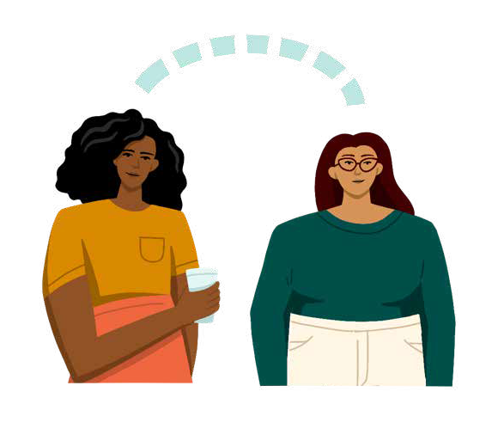
Workplace categories
Everyday interactions
Workplace norms and expectations
Hiring
Advancement and recognition
Mentorship and sponsorship
©2021 LeanIn.Org, LLC 26
Notes:
We’ve organized this module into workplace categories, or common areas of inequity in your workplace.
There are five categories you will explore.
MODERATOR PERSONALIZATIONS: On the following slides, you are welcome to customize the category descriptions to resonate with your audience.

Slide 27
WORKPLACE CATEGORIES — 1
Everyday interactions
The day-to-day conversations, meeting dynamics, or water cooler talk where people with traditionally marginalized identities might have to contend with intentional or unintentional forms of disrespect, like microaggressions
©2021 LeanIn.Org, LLC 27
Notes:
First, there’s everyday interactions: This category includes the day-to-day conversations, meeting dynamics, or “water cooler talk” where people with traditionally marginalized identities might have to contend with intentional or unintentional forms of disrespect, like microaggressions.

Slide 28
WORKPLACE CATEGORIES — 2
Workplace norms and expectations
Workplace norms, including everything from the way we set up our physical workspaces, to the hours we expect our colleagues to be available, to the software and tools we use
©2021 LeanIn.Org, LLC 28
Notes:
The second category is workplace norms and expectations: This category covers workplace norms, including everything from the way we set up our physical workspaces, to the hours we expect our colleagues to be available, to the software and tools we use.

Slide 29
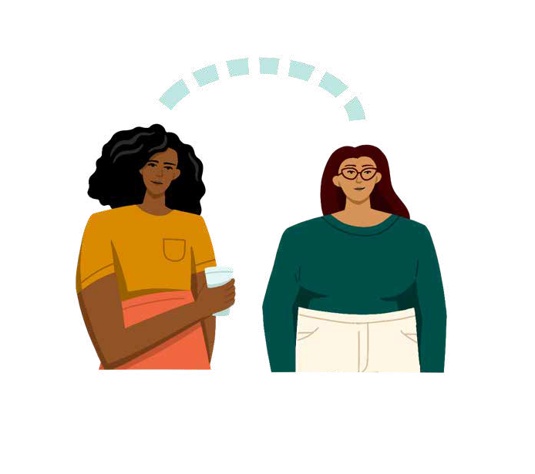
WORKPLACE CATEGORIES — 3
Mentorship and sponsorship
Access to mentors, sponsors, and senior leaders—which has long-lasting implications for how successful we are in our careers
©2021 LeanIn.Org, LLC 29
Notes:
Third, is mentorship and sponsorship: This category covers our access to mentors, sponsors, and senior leaders—which has long-lasting implications for how successful we are in our careers.

Slide 30
WORKPLACE CATEGORIES — 4
Advancement and recognition
Recognition for ideas or contributions, or opportunities for advancement like high-profile projects or promotions
©2021 LeanIn.Org, LLC 30
Notes:
Fourth is advancement and recognition: This category includes recognition for ideas or contributions, or opportunities for advancement like high-profile projects or promotions.

Slide 31
WORKPLACE CATEGORIES — 5
Hiring
Experiences applying or interviewing for jobs
©2021 LeanIn.Org, LLC 31
Notes:
Finally, hiring: This category explores experiences applying or interviewing for jobs.

Slide 32
Reminders before getting started:
INDIVIDUAL ACTIVITY
Workplace inequities exploration
Understanding our privilege is central to allyship.
It is not an assessment—you won’t get a privilege score.
This list are examples so it’s not exhaustive of all experiences.
©2021 LeanIn.Org, LLC 32
Notes:
In this next exercise, you will look at how your privilege can show up in the workplace. You will read and explore statements that will be organized by the workplace categories we just talked about.
Similar to the last exercise, this is an exploration. It’s not an assessment, meaning you’re not going to get a privilege score. Some statements will reflect your experiences, and others will not.
This list is meant to show you examples of how different identities experience privilege specifically at work—by no means is it exhaustive.
The goal as you go through is to start to understand how your privileges influence your experiences in the workplace - and how others who don’t share those privileges have different experiences.

Slide 33
INDIVIDUAL ACTIVITY
INEQUITY IN EVERYDAY INTERACTIONS:
 | I have never heard a colleague make a cruel joke about people like me LISTEN TO STORY >
 | My colleagues don’t comment about my culture or religion in ways that make me feel excluded or demeaned SEE DATA >
 | No one has ever asked to touch my hair at work SEE DATA >
 | Coworkers don’t confuse me with others of my race LISTEN TO STORY > SEE DATA >
 | I rarely hear comments suggesting I’m not dressed professionally enough SEE DATA >
 | People rarely or never call me “emotional” when I express my opinion at work SEE DATA >
 | I can talk about my personal life without feeling like I’m coming out or explaining myself SEE DATA >
 | I don’t often feel othered by the words my colleagues use LISTEN TO STORY > SEE DATA >
1
Add a next to all of the statements that apply to you
2
Learn more by clicking LISTEN TO STORY > or SEE DATA > for each statement you selected
3
Once you’ve finished, move onto the next category
ADVANCE TO THE NEXT CATEGORY >
©2021 LeanIn.Org, LLC 33
Notes:
Here’s how this will work.
(1) Similar to the last activity, you will add a check mark (✔) next to all of the privilege statements that apply to you for that category
(2) After you’ve made your selections, learn more about a few of the selected statements by clicking LISTEN TO STORY or SEE DATA for each statement.
(3) You can navigate back and forth to read through each. Once you’ve finished learning more about your statements, move on to a new category and repeat.
You can choose to start with whichever category you’d like, and if you’re not sure where to start – start with Everyday Interactions

Slide 34
Turn to page 17 and explore
workplace inequities
INDIVIDUAL ACTIVITY
PAGES: 17–68
15 MINUTES
©2021 LeanIn.Org, LLC 34
Notes:
You will spend the next 15 minutes individually exploring all five workplace categories on pages 17-68
Try to move to a new category every few minutes – this will help you make it through all five categories, even if you can’t fully explore all the statements in each category
Feel free to turn your camera off and turn it back on when you’re done
As you complete this activity, keep note of which stories or data stands out to you and why that might be.
[Set timer for 15 minutes, then nudge participants halfway through the allotted time]

Slide 35
Discussion about workplace inequities
BREAKOUT DISCUSSION
Goal: Understand the systemic barriers that hold people with traditionally marginalized identities back in the workplace
Tips for practicing allyship in this space
Respect privacy—don’t ask others to share their personal experiences.
If someone wants to share, create space and don’t question or invalidate what they say.
Be particularly mindful of your a-ha moments during this discussion. Think about how they may land for others in your group before—or while—sharing.
Discussion prompts
What data or story stood out to you? Whom does it impact?
Do you see any of the inequities you read about in your workplace? If so, how?
Have you noticed other inequities in your workplace within these categories?
©2021 LeanIn.Org, LLC 35
Notes:
Phew, I know that was a lot!
Now, we’ll move into our third breakout group discussion.
The goal of this discussion is to understand the systemic barriers that hold people with traditionally marginalized identities back in the workplace.

Slide 36
Turn to page 69 and discuss the prompts
BREAKOUT DISCUSSION
PAGE: 69
15 MINUTES
©2021 LeanIn.Org, LLC 36
Notes:
The discussion questions are on page 69 of your Personal Workbook for you to reference – you’ll have 15 minutes for this discussion.
[Set timer for 15 minutes]

Slide 37
Identify inequities at work
Active Allyship
Framework
See your privilege
Consider actions to take
Own your positional power
©2021 LeanIn.Org, LLC 37
Notes:
Let’s take a quick look at the Active Allyship Framework before we move into a break.
Earlier, we took a look at the privileges we hold, which is core to practicing allyship.
We just dug into inequities that exist at work, meaning the problems at work.
Next, we’ll spend time reflecting on your power at work and specific strategies and actions to take.

Slide 38
BREAK
Join us back here in 10 minutes
©2021 LeanIn.Org, LLC 38
Notes:
Now, we’ll move into a 10 minute break. When we come back, we’ll jump into discovering our power.
[Set timer for 10 minutes and tell participants a particular time to come back to the main room]

Slide 39
1
2
3
4
5
6
7
Define allyship
4
Unpack your privilege
Uncover workplace inequities
Discover your power
Discover your power
Learn allyship actions
Review the Active Allyship Framework
Introduce the follow-up sessions
©2021 LeanIn.Org, LLC 39
Notes:
Now, let's jump in and start discovering the power we have in the workplace
.

Slide 40
WHAT DO WE MEAN BY POWER?
Your power is your ability to make an impact
©2021 LeanIn.Org, LLC 40
Notes:
To start, what do we mean by power?
For the purposes of this workshop, we’ll be defining power as your ability to make an impact at work. When we leverage that power to help others, we can begin showing up as effective allies at work.

Slide 41
WHAT DO WE MEAN BY POWER?
Positional power: the power you have based on your role and level
©2021 LeanIn.Org, LLC 41
Notes:
Power can be influenced by a number of factors - including but not limited to our position at work, our privileges, and our relationships.
For the purposes of this workshop we’ll be focusing on positional power - the power you have that’s based on your role and level.
That often means that as you become more senior, you have more power to enact change and influence company culture.

Slide 42
WHAT DO WE MEAN BY POWER?
We all have forms of power.
©2021 LeanIn.Org, LLC 42
Notes:
And it’s important to remember we all have forms of power.
Often, we underestimate our power and the impact it can have, especially when we're earlier in our careers or not as senior. But participation across levels of an organization can make a big difference.
Maybe you aren't a hiring manager, but you do participate in the interview process.
Maybe you don't run a large team, but you do run weekly meetings with a lot of attendees.
Or maybe you don't make decisions about workplace facilities, but you have a friendly relationship with the person who picks the location for informal social events.
MODERATOR PERSONALIZATION: This is a great place to customize examples of power to your particular workplace.
Participation at all levels of an organization can make a big difference.
In fact, research shows that when employees at all levels are invested in organizational change and act as change agents, the new behaviors stand more chance of becoming shared values and parts of the culture

Slide 43
Your power
Everyday interactions
Workplace norms and expectations
Hiring
Advancement and recognition
Mentorship and sponsorship
©2021 LeanIn.Org, LLC 43
Notes:
Now that we’ve defined power, we’ll brainstorm what opportunities we each have at work, using the same workplace categories that we explored earlier. These were:
Everyday interactions
Workplace norms and expectations
Mentorship and sponsorship
Advancement and recognition
Hiring

Slide 44
Turn to page 71 and answer
the questions about your power
INDIVIDUAL ACTIVITY
PAGES: 71–75
5 MINUTES
©2021 LeanIn.Org, LLC 44
Notes:
Now you will turn to page 71 in your Personal Workbook and respond to the prompts provided on pages 71–75
Through this exercise you will be identifying your power through the lens of the decisions you make or tasks you work on.
We have provided a few thought starters at the bottom of each slide in your workbook, if you feel stuck
You’ll have 5 minutes to go through all 5 categories – try to write something for each category
Feel free to turn off your videos for this activity, and turn them back on when you’re done.
As you complete this activity, think about a type of power that you’d never thought of before, and how it might be used to practice allyship.

Slide 45
Discussion about power
BREAKOUT DISCUSSION
Goal: Understand your power to enact change in your organization
Tips for practicing allyship in this space
Remember to create space for everyone in your breakout group to share.
Discussion prompts
Share one type of power you have that you'd never thought of before. If there’s time, push yourself to share a second from a different workplace category.
What opportunities do you have to use your power to practice allyship?
How might your privilege contribute to the power you have in your workplace—whether your role or your level?
©2021 LeanIn.Org, LLC 45
Notes:
Now, we're going to move into breakout groups to discuss the journal prompts.
The goal is to understand your power to enact change in your organization. Remember to create space for everyone in your breakout group to share.

Slide 46
Turn to page 77 and discuss the prompts
BREAKOUT DISCUSSION
PAGE: 77
15 MINUTES
©2021 LeanIn.Org, LLC 46
Notes:
Turn to page 77 in your Personal Workbook to get started.
You’ll have about 15 minutes to discuss
[Set timer for 15 min]

Slide 47
Identify inequities at work
Active Allyship
Framework
See your privilege
Consider actions to take
Own your positional power
©2021 LeanIn.Org, LLC 47
Notes:
Welcome back – I hope your discussions were fruitful.
Let’s take another quick look at the framework.
You just reflected on and discussed your positional power, or the ability you have to enact change at work.
Situated within the Active Allyship Framework, you can see it as another way to spark allyship. It helps articulate what opportunities you have and how you are positioned to be most effective.

Slide 48
1
2
3
4
5
6
7
Define allyship
5
Unpack your privilege
Learn allyship actions
Uncover workplace inequities
Discover your power
Learn allyship actions
Review the Active Allyship Framework
Introduce the follow-up sessions
©2021 LeanIn.Org, LLC 48
Notes:
We’ll spend the next part of the workshop exploring the specific strategies and actions we can take to practice allyship effectively.

Slide 49
©2021 LeanIn.Org, LLC 49
Notes:
To start, we’ll watch a short video about the framework for understanding the strategies and actions we’re about to dive into.
While you’re watching the video, think about what type of allyship action you’re drawn to most
If you have any issues playing this video in the presentation, you can play the video here: https://youtu.be/f3f_pHYo2rM

Slide 50
TODAY
FOLLOW-UP SESSIONS
1
Create or help facilitate more inclusive meetings
3
Contribute to or create fairer hiring and promotion practices
Allyship
strategies
2
Prioritize inclusion in your work product
4
Proactively create an inclusive culture
5
Intentionally invest in the advancement of people with traditionally marginalized identities
©2021 LeanIn.Org, LLC 50
Notes:
In this program, there are five overarching strategies for practicing allyship, and a variety of specific actions to take under each one.
Today during this workshop, we’ll explore two of the five strategies.

Slide 51
TODAY
FOLLOW-UP SESSIONS
1
Create or help facilitate more inclusive meetings
3
Contribute to or create fairer hiring and promotion practices
Allyship
strategies
2
Prioritize inclusion in your work product
4
Proactively create an inclusive culture
5
Intentionally invest in the advancement of people with traditionally marginalized identities
©2021 LeanIn.Org, LLC 51
Notes:
And in each of the follow-up sessions, we’ll tackle the other three

Slide 52
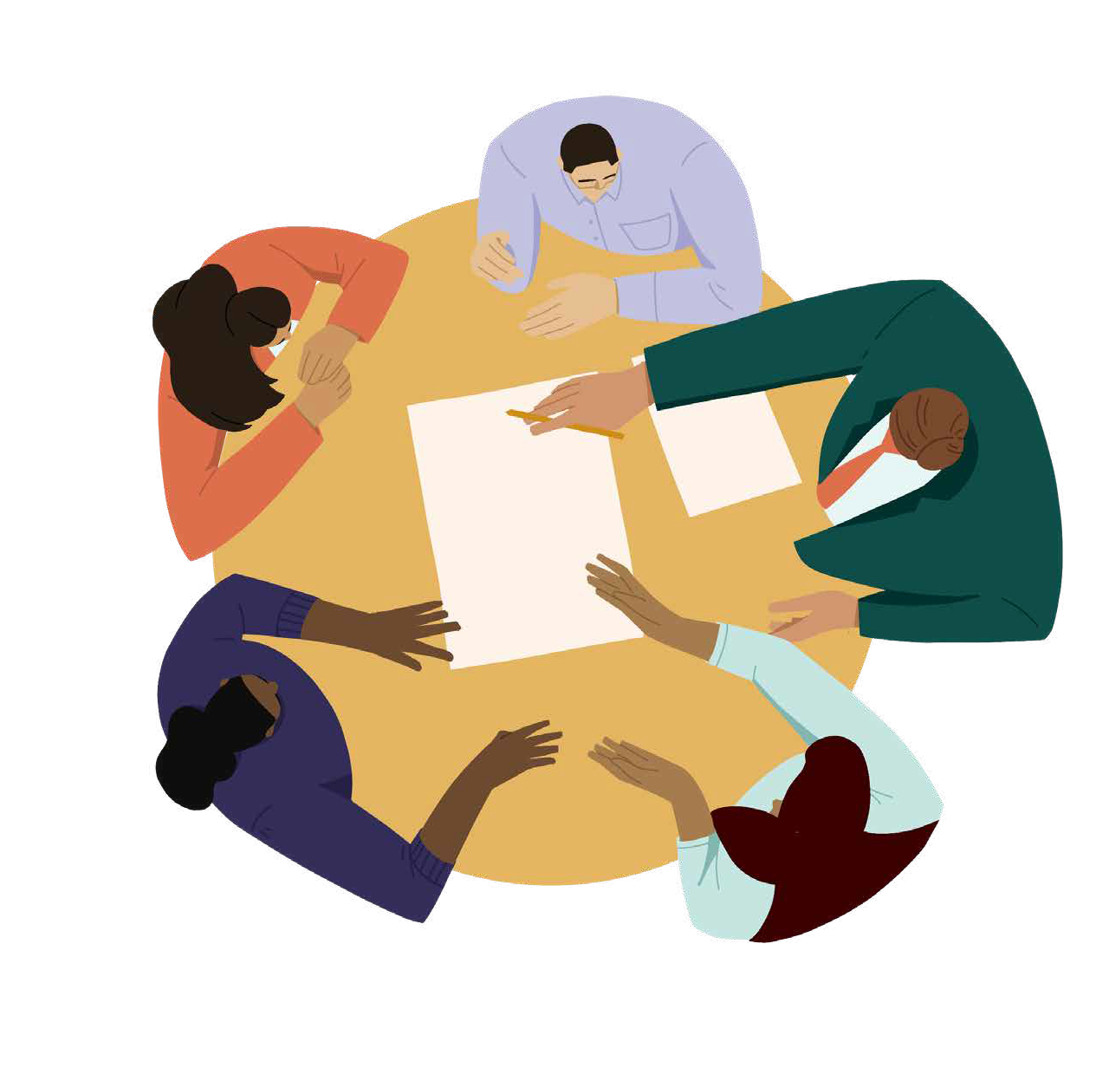
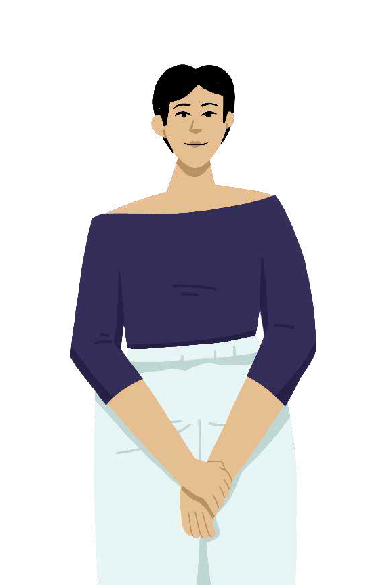
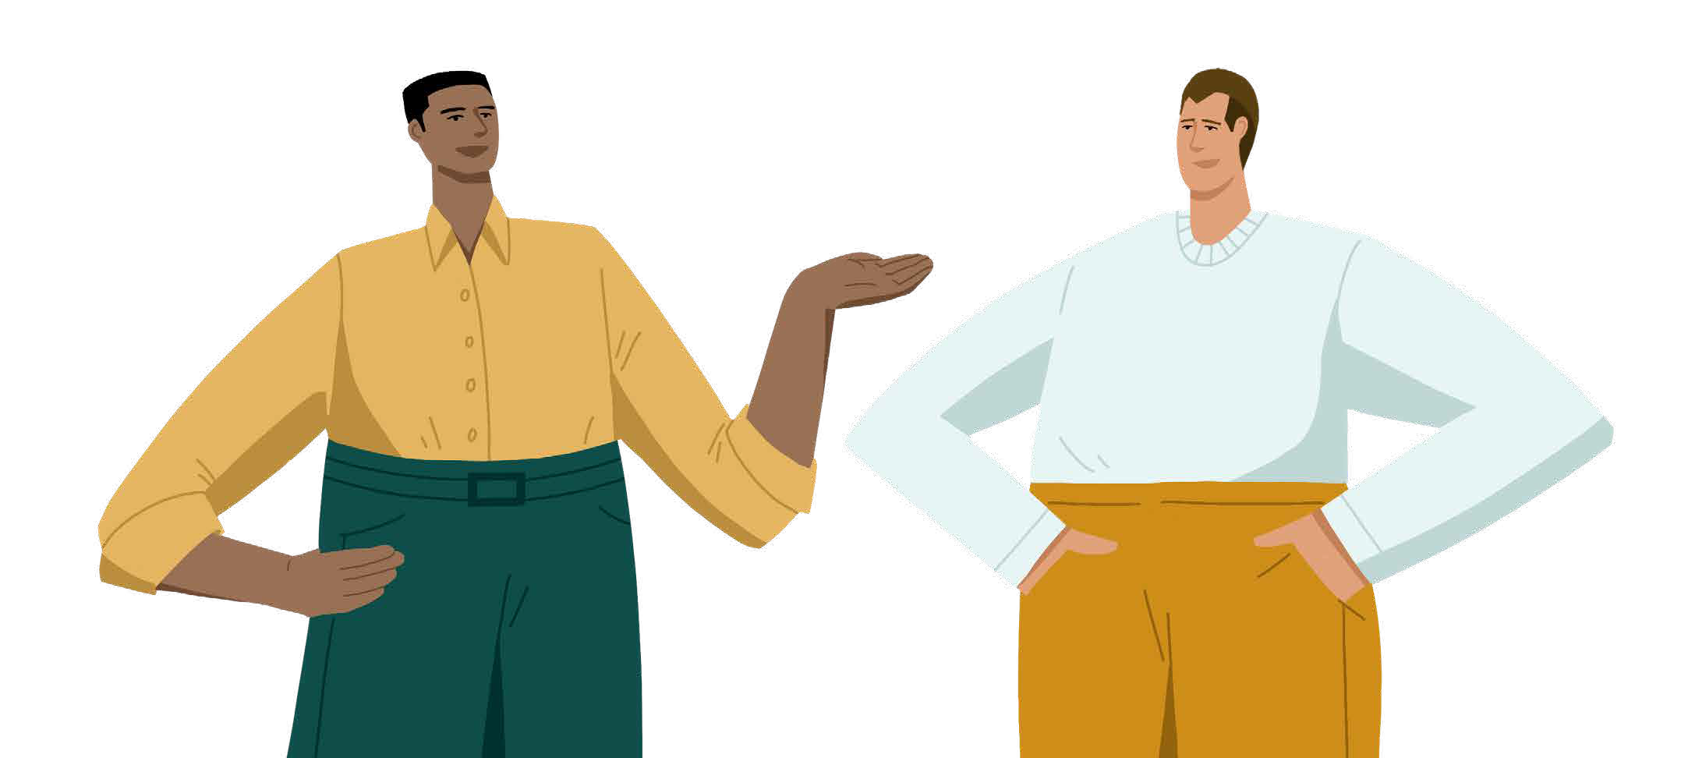
Types of allyship actions
Individual
Our actions to educate ourselves, model good behavior, or change our mindset
Interpersonal
Our actions to support, surface issues or push for changes through our day-to- day interactions with others
Structural
Our actions pushing for change in norms, policies, or systems
©2021 LeanIn.Org, LLC 52
Notes:
The actions under each strategy fall under the framework for the types of allyship actions we can take – individual, interpersonal, and structural.
Individual allyship: Our actions to educate ourselves, model inclusive behavior, or change our mindset
Interpersonal allyship: Our actions to support, surface issues or push for changes through our day-to-day interactions with others
Structural allyship: Our actions pushing for change in norms, policies, or systems. A quick note on structural allyship actions: The following strategies are based on practices and policies that can create more inclusive workplaces. While every idea on the list might not be feasible for your company, it’s likely that some are.If you’re a leader, you might have the ability to institute or encourage these practices yourself. If you’re earlier in your career, these are suggestions to ask about or advocate for. This type of bottom-up advocacy is crucial in using your privilege to support and advance those with traditionally marginalized identities. In other words, it’s how you practice allyship to drive structural change.

Slide 53
Create or help facilitate more inclusive meetings
ALLYSHIP STRATEGIES — 1
Meetings are a critical part of the workplace—they’re where we build credibility, collaborate, earn respect from colleagues, and interact with peers and leadership. But they can also be times when people with less privilege are less heard than others. If you typically schedule or facilitate meetings or gather with your team in small groups, learn about the actions you can take to make them more inclusive. And if you don’t facilitate meetings but do often attend them, learn about how you can show up as an ally.
©2021 LeanIn.Org, LLC 53
Notes:
The first strategy we’re going to tackle is create or help to facilitate more inclusive meetings. At the beginning of your personal exploration, you’ll read this description first.

Slide 54
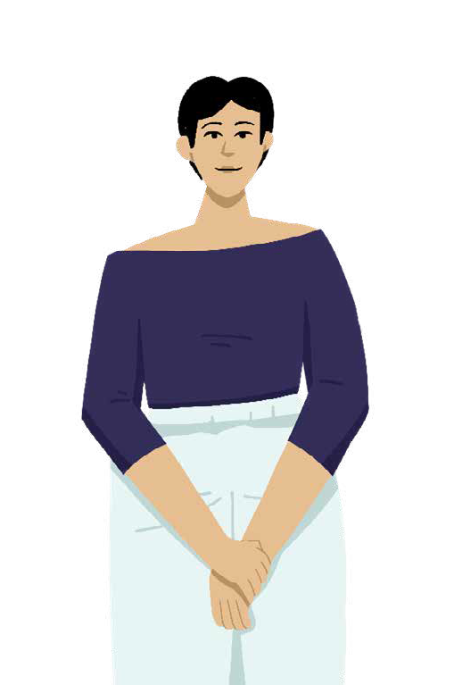
Create or help facilitate more inclusive meetings
ALLYSHIP STRATEGIES — 1
Individual
Share your pronouns
Use inclusive language
Observe group dynamics
Challenge your bias
Interpersonal
Reduce interruptions
Give credit
Invite more voices
Structural
Distribute speaking time
Ensure meeting environments are accessible
Create systems to distribute “office housework”
©2021 LeanIn.Org, LLC 54
Notes:
Then, you’ll explore the individual, interpersonal, and structural actions within this strategy
You’ll have about 15 minutes to read through all of them – some actions have audio stories that you can listen to, too.
Some actions will resonate more with you than others. That’s OK – this list introduces you to a wide range of actions so you can find what’s most relevant
Feel free to turn off your cameras while you explore, and don’t forget to put yourself on mute for the audio stories
As you explore this strategy, think about which action stands out to you under each category.

Slide 55
Turn to page 80 and
explore the actions
INDIVIDUAL ACTIVITY
PAGES: 80–92
15 MINUTES
©2021 LeanIn.Org, LLC 55
Notes:
Turn to page 80 and get started.
[Set timer for 15 minutes]

Slide 56
Discussion about allyship strategies
BREAKOUT DISCUSSION
Goal: Learn specific allyship actions you can take based on your positional power—and brainstorm how to apply them at your workplace
Tips for practicing allyship in this space
Remember to create space for everyone in your breakout group to share.
If someone shares a story, do not question or invalidate their experience.
Discussion prompts
Talk about one individual, interpersonal, and structural action. For each action, discuss:
What would it look like for you to practice that action in your role at your organization? Whom would you talk to, what would you do, or how would you get started?
What inequity will that action address? What group will it advance or support?
What challenges might you face? How might you—individually or with others in your group—start to work through those?
©2021 LeanIn.Org, LLC 56
Notes:
Now, we’ll move into your breakout groups to discuss inclusive meetings
The goal of the discussion is to uncover what specific allyship actions you can take based on your positional power—and brainstorm how to apply them at your workplace.
Tips for practicing allyship in this space:
This is a good place to problem solve common challenges you might encounter when trying to practice allyship with your group.
To help problem solve, try to figure out the root of the problem: whether it’s pushback you might face, confusion around how to approach someone, or something else entirely.
You can also share when you’ve been frustrated by a lack of allyship when you were in need of it.
If the actions aren’t feeling realistic, push each other to talk about why that is. Discuss what is unique about your organization and what allyship might look like given those circumstances.

Slide 57
Turn to page 93 and discuss the prompts
BREAKOUT DISCUSSION
PAGE: 93
15 MINUTES
©2021 LeanIn.Org, LLC 57
Notes:
Now, we’ll place you in breakout groups and you can turn to page 93 to start your discussion.
You will have 15 minutes to discuss
[Set timer for 15 minutes]

Slide 58
BREAK
Join us back here in 10 minutes
©2021 LeanIn.Org, LLC 58
Notes:
Welcome back – I hope you learned some inspiring or interesting allyship actions. We’re now going to take a 10 minute break before we jump into the next strategy.
[Set timer for 10 minutes and tell participants a particular time to come back to the main room]

Slide 59
Prioritize inclusion in your work product
ALLYSHIP STRATEGIES — 2
Most of us have an opportunity to make the work that we produce on a day-to-day basis more inclusive. Whether it’s the language we use in internal and external communications, the way we build web pages, or the imagery we select for marketing materials, our choices impact whom our work resonates with and who can use it. Learn how to make intentional choices as part of your daily work.
©2021 LeanIn.Org, LLC 59
Notes:
The second strategy we’re going to tackle is prioritize inclusion in your work product.
Similar to the last strategy, you’ll start your exploration by reading a short description about it.

Slide 60
Prioritize inclusion in your work product
ALLYSHIP STRATEGIES — 2
Individual
Reflect on how bias shows up in your work
Showcase a wide range of identities
Use inclusive language
Seek out best accessibility practices
Interpersonal
Ask for input
Communicate your values
Share ideas with colleagues
Structural
Set diversity, equity, and inclusion requirements for partners, vendors, and suppliers
Include equity in your definition of success
©2021 LeanIn.Org, LLC 60
Notes:
Then, you’ll explore the individual, interpersonal, and structural actions within this strategy
You’ll have about 15 minutes to read through all of them – some actions have audio stories that you can listen to
Feel free to turn off your cameras while you explore, and don’t forget to put yourself on mute for the audio stories

Slide 61
Turn to page 95 and
explore the actions
INDIVIDUAL ACTIVITY
PAGES: 95–106
15 MINUTES
©2021 LeanIn.Org, LLC 61
Notes:
Turn to page 95 and get started.
[Set timer for 15 minutes]

Slide 62
Discussion about allyship strategies
BREAKOUT DISCUSSION
Goal: Learn specific allyship actions you can take based on your positional power—and brainstorm how to apply them at your workplace
Tips for practicing allyship in this space
Remember to create space for everyone in your breakout group to share.
If someone shares a story, do not question or invalidate their experience.
Discussion prompts
Talk about one individual, interpersonal, and structural action. For each action, discuss:
What would it look like for you to practice that action in your role at your organization? Whom would you talk to, what would you do, or how would you get started?
What inequity will that action address? What group will it advance or support?
What challenges might you face? How might you—individually or with others in your group—start to work through those?
©2021 LeanIn.Org, LLC 62
Notes:
Now, we’ll move into your breakout groups to discuss this strategy
The goal is to learn specific allyship actions you can take based on your positional power - and brainstorm how to apply them at your workplace.
Tips for practicing allyship in this space:
Remember to create space for everyone in your breakout group to share.
If someone shares a story, do not question or invalidate their experience.
You will have 15 minutes to discuss
[Set timer for 15 minutes]

Slide 63
Turn to page 108 and discuss the prompts
BREAKOUT DISCUSSION
PAGE: 108
15 MINUTES
©2021 LeanIn.Org, LLC 63
Notes:
Turn to Slide 108 to find the prompts. You will have 15 minutes to discuss
[Set timer for 15 minutes]

Slide 64
1
2
3
4
5
6
7
Define allyship
6
Unpack your privilege
Uncover workplace inequities
Review
the Active Allyship
Framework
Discover your power
Learn allyship actions
Review the Active Allyship Framework
Introduce the follow-up sessions
©2021 LeanIn.Org, LLC 64
Notes:
Great, welcome back everyone! To close out today’s workshop, we’ll dig into the Active Allyship Framework.

Slide 65
Identify inequities at work
Active Allyship
Framework
See your privilege
Consider actions to take
Own your positional power
©2021 LeanIn.Org, LLC 65
Notes:
Throughout the workshop, we’ve explored the different elements of the framework.
As we now know, there are many ways to practice allyship depending on what privileges you have to leverage, what the problems or inequities are, what power or opportunities you have, and what action you want to take.
The Active Allyship Framework is meant to help you connect the dots between these pieces - to think about how to best use your privilege and power to address inequities (or in other words, how to practice allyship)
The framework is not linear - you don’t have to use it in any particular order - and you don’t need to formally run through it before acting as an ally. But it can be a helpful tool for planning or reflection along your allyship journey.
In your follow-up sessions, you’ll practice filling out this framework as an exercise to hold yourself accountable along your allyship journey. The purpose of the framework is to show how privilege, inequities and your positional power are all connected in your ability to show up as an ally, and to help you remember the components of allyship. There are no right answers, and it’s ok if you can’t fill out every box in the framework. You’ll unpack your Active Allyship Framework with your group and discuss where you might have gotten stuck or how it helped you to think about your own allyship actions.

Slide 66
1
Define allyship
Allyship is an active and consistent effort to use your privilege and power to support and advocate for people with less privilege.
Today we covered…
2
Unpack your privilege
3
Learn about inequities in the workplace
©2021 LeanIn.Org, LLC 66
Notes:
Let’s review what we covered today to wrap up the workshop. First, we defined allyship.
We learned that allyship is an active and consistent effort to use your privilege and power to support and advocate for people with less privilege.

Slide 67
1
Define allyship
Allyship is an active and consistent effort to use your privilege and power to support and advocate for people with less privilege.
Today we covered…
2
Unpack your privilege
Privilege gives some of us advantages that propel us forward, while simultaneously creating barriers that hold others back.
3
Learn about inequities in the workplace
©2021 LeanIn.Org, LLC 67
Notes:
Then, we unpacked our privilege.
We examined our own privilege, inside and outside of the workplace.
We saw how privilege gives some of us advantages that propel us forward, while simultaneously creating barriers that hold others back.

Slide 68
1
Define allyship
Allyship is an active and consistent effort to use your privilege and power to support and advocate for people with less privilege.
Today we covered…
2
Unpack your privilege
Privilege gives some of us advantages that propel us forward, while simultaneously creating barriers that hold others back.
3
Learn about inequities in the workplace
Understanding the systemic injustices that hold people back at work is critical to making your allyship most impactful.
©2021 LeanIn.Org, LLC 68
Notes:
Then, we discussed inequities in the workplace
We explored systemic inequities that hold people back at work. In other words, we learned to start to see the problems so that we can also see the opportunities to show up as allies.

Slide 69
4
Discover your power
We learned that our power is our ability to make an impact at work—and that our positional power is the power we have that’s based on our role and level.
Today we covered…
5
Learn allyship actions
6
Review the Active Allyship Framework
©2021 LeanIn.Org, LLC 69
Notes:
We then uncovered our positional power.
We learned that our power is our ability to make an impact at work - and that our positional power is the power we have that’s based on our role and level.

Slide 70
4
Discover your power
We learned that our power is our ability to make an impact at work—and that our positional power is the power we have that’s based on our role and level.
Today we covered…
5
Learn allyship actions
We dove into the strategies to practice allyship—and specific individual, interpersonal, or structural actions. And we each identified some actions that we can practice given our power and privilege.
6
Review the Active Allyship Framework
©2021 LeanIn.Org, LLC 70
Notes:
Then, we learned allyship actions:
We dove into the actions to practice allyship - across individual, interpersonal, or structural strategies. And we each identified some strategies that we can practice given our power and privilege.

Slide 71
4
Discover your power
We learned that our power is our ability to make an impact at work—and that our positional power is the power we have that’s based on our role and level.
Today we covered…
5
Learn allyship actions
We dove into the strategies to practice allyship—and specific individual, interpersonal, or structural actions. And we each identified some actions that we can practice given our power and privilege.
6
Review the Active Allyship Framework
We explored a framework we’ll use in the follow-up sessions to hold ourselves accountable to practicing allyship centered on the inequities people face and the power we hold in our workplaces.
©2021 LeanIn.Org, LLC 71
Notes:
Finally, we reviewed the Active Allyship Framework
We explored the components to practicing allyship – seeing your privilege, noticing the problems at work, identifying opportunities to practice allyship, and finally learning about specific actions to take.

Slide 72
Turn to page 111 and
write down your One Commitment
INDIVIDUAL ACTIVITY
PAGE: 111
3 MINUTES
©2021 LeanIn.Org, LLC 72
Notes:
We’re going to close out our Allyship at Work workshop by making One Commitment for something we’ll do to continue our allyship journey between now and the next session.
I will give you 2-3 minutes to journal about what your One Commitment is – meaning what you hope to accomplish to between now and the follow-up session. You’ll bring these back to your breakout group in your follow-up session, as a way of discussing your continued work on your allyship journey.
That might mean practicing an action or two that you discussed with your group.
It could also mean reviewing your workplace privilege statements, rewatching some of the videos, or talking to someone else in the workshop about allyship to continue your journey together.
Once you’ve written it down, I welcome you to share it in the chat
[Set timer for 2-3 minutes]
Now, I’d like to invite a couple of people to share their One Commitment out loud with the group
[Encourage participants to share aloud. If no one feels comfortable, read a few commitments from the chat aloud]
Thank you for sharing your One Commitments. You will continue to develop and check in on these commitments in your follow-up sessions.

Slide 73
1
2
3
4
5
6
7
Define allyship
7
Unpack your privilege
Introduce the follow-up
sessions
Uncover workplace inequities
Discover your power
Learn allyship actions
Review the Active Allyship Framework
Introduce the follow-up sessions
©2021 LeanIn.Org, LLC 73
Notes:
The program doesn’t end here—in the next phase of the program you will be meeting just with your breakout groups once a month, for the next 3 months. These follow-up sessions will help you build new habits and commit to practicing allyship over the long term.

Slide 74
Follow-up Sessions Agenda
1 hour
1
Reflect on your One Commitment
10 min
2
Explore a new allyship strategy
30 min
3
Practice using the Active Allyship Framework
15 min
4
Make your One Commitment
5 min
©2021 LeanIn.Org, LLC 74
Notes:
In each session, you will check in on your One Commitment, explore new allyship actions, and discuss your allyship journey with your breakout group.
I will send a follow-up email with more information about the follow-up sessions as well as a short survey to complete about your experience in this workshop.

Slide 75
THANKS FOR PARTICIPATING IN TODAY’S WORKSHOP
©2021 LeanIn.Org, LLC 75
Notes:
Thank you for taking the time to be in this workshop with us. We’re so grateful that you all chose to be here today – so much of allyship, as we hope you’ve learned, is about showing up and actually doing the work, including learning the foundation and what actions you can take.
MODERATOR PERSONALIZATIONS: As you close out the workshop, this is a great place to customize and share your thoughts on how you will carry this program forward within your organization or provide any closing advice for the group.

Slide 76
FOLLOW-UP SESSIONS
©2021 LeanIn.Org, LLC 76
Notes:
Hello again! My name is [INSERT NAME] and I use [INSERT PRONOUNS].
Welcome to the first follow-up session of Lean In’s Allyship at Work program

Slide 77
SESSION #1
Follow-up sessions
1
Strategy 3: Contribute to or create fairer hiring and promotion practices
2
Strategy 4: Proactively create an inclusive culture
3
Strategy 5: Intentionally invest in the advancement of people with traditionally marginalized identities
©2021 LeanIn.Org, LLC 77
Notes:
Welcome to to the first of three follow-up sessions. Today you will dive into the 3rd strategy: Contributing to or creating fairer hiring and promotion practices. You will spend the entire time in your breakout group – the same group as the last time we met.

Slide 78
Session #1 Agenda
1 hour
1
Reflect on your One Commitment
10 min
2
Explore Strategy 3: Contribute to or create fairer hiring and promotion practices
30 min
3
Practice using the Active Allyship Framework
15 min
4
Make your One Commitment
5 min
©2021 LeanIn.Org, LLC 78
Notes:
Here is the agenda for today’s session. You’ll start by reflecting on the One Commitment, explore and discuss a new allyship strategy, and practice using the Active Allyship Framework, before making another commitment.

Slide 79
Instructions
MODERATOR SHARE SCREEN
Welcome back! Here is what you need to know for today:
Pages 116 through 148 in your workbook will walk you and your breakout group through everything you need for today’s session.
Start by picking one person to facilitate today’s conversation. This person is responsible for:
Managing the agenda and keeping the group on track to finish on time
Sharing their screen during group work (pages to share will be marked with a purple box in the upper right corner, as shown above)
Coordinating with the group to take turns reading shared pages aloud
©2021 LeanIn.Org, LLC 79
Notes:
Today you’ll be in your breakout group for the duration of our time together. pages 116 through 148 in your workbook will walk your group through exactly what to do.
I will place you in breakouts shortly, and the first thing you’ll want to do is pick one person to moderate today’s conversations. This person will be responsible for sharing their screen for the group and keeping time. As a group you should also coordinate who will read the shared pages aloud.

Slide 80
Share the mic
Make space for everyone to speak. Step back if you often share first or when exploring areas where you hold privilege.
How to practice
allyship in breakout groups
Commit to confidentiality
Don’t use other people’s names when sharing stories and keep everything shared confidential.
Be mindful of your a-ha moments
When you see something through a new lens, remember that it might be part of someone else’s day-to-day. Be aware of how your sharing will land for them.
Don’t question others’ experiences
Don’t question or discount the lived experiences of others.
Give one another grace
Believe one another’s best intentions and be patient when mistakes are made.
©2021 LeanIn.Org, LLC 80
Notes:
As a reminder for today’s breakout session, we ask that you follow our ground rules as ways to practice allyship in your breakout groups
SHARE THE MIC: We want everyone to have a chance to speak. Particularly if you’re exploring an area where you hold a lot of privilege, be mindful of not dominating the conversation.
COMMIT TO CONFIDENTIALITY. Don’t use other people’s names when sharing stories and keep everything shared confidential.
BE MINDFUL OF YOUR A-HA MOMENTS: This program is meant to prompt you to see your experiences at work – and the experiences of others – through a new lens. Be mindful that while you may be seeing something in a new way, for some it may be part of their day-to-day experiences. If you choose to share an a-ha moment, be aware that your surprise at discovering these experiences may be painful for others who live them daily. As an ally, prioritize the impact that your sharing may have on others in your group over your excitement to share it.
DON’T QUESTION OTHERS' EXPERIENCES: We all bring different experiences to the table - do not discount or invalidate the lived experiences of others. In particular, if someone shares about an inequity they’ve faced, believe their experience. Do not ask for proof or try to provide an alternate point of view.
GIVE EACH OTHER GRACE: Some of these conversations may be uncomfortable. Believe one another's best intentions and be patient when mistakes are made.

Slide 81
Turn to page 116 and begin your activities
BREAKOUT DISCUSSION
PAGES: 116–148
60 MINUTES
©2021 LeanIn.Org, LLC 81
Notes:
With that, I’ll send you off to your breakout room where you’ll spend the rest of the time together. You will not come back to the main room.
Refer to your workbook, starting on page 116 for all directions, and if you have any questions, feel free to message me.

Slide 82
SESSION #2
Follow-up sessions
1
Strategy 3: Contribute to or create fairer hiring and promotion practices
2
Strategy 4: Proactively create an inclusive culture
3
Strategy 5: Intentionally invest in the advancement of people with traditionally marginalized identities
©2021 LeanIn.Org, LLC 82
Notes:
Welcome to the second of three follow-up sessions. Today you will dive into the 4th strategy: Proactively creating an inclusive culture. You will spend the entire time in your breakout group – the same group as the last time we met.

Slide 83
Session #2 Agenda
1 hour
1
Reflect on your One Commitment
10 min
2
Strategy 4: Proactively create an inclusive culture
30 min
3
Practice using the Active Allyship Framework
15 min
4
Make your One Commitment
5 min
©2021 LeanIn.Org, LLC 83
Notes:
Here’s the agenda for today’s session. You’ll start by reflecting on the One Commitment, explore and discuss a new allyship strategy, and practice using the Active Allyship Framework, before making another commitment.

Slide 84
Instructions
MODERATOR SHARE SCREEN
Welcome back! Here is what you need to know for today:
Pages 150 through 182 in your workbook will walk you and your breakout group through everything you need for today’s session.
Start by picking one person to moderate today’s conversation. This person is responsible for:
Managing the agenda and keeping the group on track to finish on time
Sharing their screen during group work (pages to share will be marked with a purple box in the upper right corner, as shown above)
Coordinating with the group to take turns reading shared pages aloud
©2021 LeanIn.Org, LLC 84
Notes:
Today you’ll be in your breakout group for the duration of our time together. pages 150 through 182 in your workbook will walk your group through exactly what to do.
I will place you in breakouts shortly, and the first thing you’ll want to do is pick one person to moderate today’s conversations. This person will be responsible for sharing their screen for the group and keeping time. As a group you should also coordinate who will read the shared pages aloud.

Slide 85
Share the mic
Make space for everyone to speak. Step back if you often share first or when exploring areas where you hold privilege.
How to practice
allyship in breakout groups
Commit to confidentiality
Don’t use other people’s names when sharing stories and keep everything shared confidential.
Be mindful of your a-ha moments
When you see something through a new lens, remember that it might be part of someone else’s day-to-day. Be aware of how your sharing will land for them.
Don’t question others’ experiences
Don’t question or discount the lived experiences of others.
Give one another grace
Believe one another’s best intentions and be patient when mistakes are made.
©2021 LeanIn.Org, LLC 85
Notes:
As a reminder for today’s breakout session, we ask that you follow our ground rules as ways to practice allyship in your breakout groups
SHARE THE MIC: We want everyone to have a chance to speak. Particularly if you’re exploring an area where you hold a lot of privilege, be mindful of not dominating the conversation.
COMMIT TO CONFIDENTIALITY. Don’t use other people’s names when sharing stories and keep everything shared confidential.
BE MINDFUL OF YOUR A-HA MOMENTS: This program is meant to prompt you to see your experiences at work – and the experiences of others – through a new lens. Be mindful that while you may be seeing something in a new way, for some it may be part of their day-to-day experiences. If you choose to share an a-ha moment, be aware that your surprise at discovering these experiences may be painful for others who live them daily. As an ally, prioritize the impact that your sharing may have on others in your group over your excitement to share it.
DON’T QUESTION OTHERS' EXPERIENCES: We all bring different experiences to the table - do not discount or invalidate the lived experiences of others. In particular, if someone shares about an inequity they’ve faced, believe their experience. Do not ask for proof or try to provide an alternate point of view.
GIVE EACH OTHER GRACE: Some of these conversations may be uncomfortable. Believe one another's best intentions and be patient when mistakes are made.

Slide 86
Turn to page 150 and begin your activities
BREAKOUT DISCUSSION
PAGES: 150–182
60 MINUTES
©2021 LeanIn.Org, LLC 86
Notes:
With that, I’ll send you off to your breakout room where you’ll spend the rest of the time together. You will not come back to the main room.
Refer to your workbook, starting on page 150 for all directions, and if you have any questions, feel free to message me.

Slide 87
SESSION #3
Follow-up sessions
1
Strategy 3: Contribute to or create fairer hiring and promotion practices
2
Strategy 4: Proactively create an inclusive culture
3
Strategy 5: Intentionally invest in the advancement of people with traditionally marginalized identities
©2021 LeanIn.Org, LLC 87
Notes:
Welcome to to the third of three follow-up sessions. Today you will dive into the 5th and final strategy: Intentionally invest in the advancement of people with traditionally marginalized identities. You will spend the entire time in your breakout group – the same group as the last time we met.

Slide 88
Session #3 Agenda
1 hour
1
Reflect on your One Commitment
10 min
2
Strategy 5: Intentionally invest in the advancement of people with traditionally marginalized identities
30 min
3
Practice using the Active Allyship Framework
15 min
4
Make your One Commitment
5 min
©2021 LeanIn.Org, LLC 88
Notes:
Here’s the agenda for today’s session. You’ll start by reflecting on the One Commitment, explore and discuss a new allyship strategy, and practice using the Active Allyship Framework, before making another commitment.

Slide 89
Instructions
MODERATOR SHARE SCREEN
Welcome back! Here is what you need to know for today:
Pages 184 through 211 in your workbook will walk you and your breakout group through everything you need for today’s session.
Start by picking one person to moderate today’s conversation. This person is responsible for:
Managing the agenda and keeping the group on track to finish on time
Sharing their screen during group work (pages to share will be marked with a purple box in the upper right corner, as shown above)
Coordinating with the group to take turns reading shared pages aloud
©2021 LeanIn.Org, LLC 89
Notes:
Today you’ll be in your breakout group for the duration of our time together. pages 184 through 211 in your workbook will walk your group through exactly what to do.
I will place you in breakouts shortly, and the first thing you’ll want to do is pick one person to moderate today’s conversations. This person will be responsible for sharing their screen for the group and keeping time. As a group you should also coordinate who will read the shared pages aloud.

Slide 90
Share the mic
Make space for everyone to speak. Step back if you often share first or when exploring areas where you hold privilege.
How to practice
allyship in breakout groups
Commit to confidentiality
Don’t use other people’s names when sharing stories and keep everything shared confidential.
Be mindful of your a-ha moments
When you see something through a new lens, remember that it might be part of someone else’s day-to-day. Be aware of how your sharing will land for them.
Don’t question others’ experiences
Don’t question or discount the lived experiences of others.
Give one another grace
Believe one another’s best intentions and be patient when mistakes are made.
©2021 LeanIn.Org, LLC 90
Notes:
As a reminder for today’s breakout session, we ask that you follow our ground rules as ways to practice allyship in your breakout groups
SHARE THE MIC: We want everyone to have a chance to speak. Particularly if you’re exploring an area where you hold a lot of privilege, be mindful of not dominating the conversation.
COMMIT TO CONFIDENTIALITY. Don’t use other people’s names when sharing stories and keep everything shared confidential.
BE MINDFUL OF YOUR A-HA MOMENTS: This program is meant to prompt you to see your experiences at work – and the experiences of others – through a new lens. Be mindful that while you may be seeing something in a new way, for some it may be part of their day-to-day experiences. If you choose to share an a-ha moment, be aware that your surprise at discovering these experiences may be painful for others who live them daily. As an ally, prioritize the impact that your sharing may have on others in your group over your excitement to share it.
DON’T QUESTION OTHERS' EXPERIENCES: We all bring different experiences to the table - do not discount or invalidate the lived experiences of others. In particular, if someone shares about an inequity they’ve faced, believe their experience. Do not ask for proof or try to provide an alternate point of view.
GIVE EACH OTHER GRACE: Some of these conversations may be uncomfortable. Believe one another's best intentions and be patient when mistakes are made.

Slide 91
Turn to page 184 and begin your activities
BREAKOUT DISCUSSION
PAGES: 184–211
60 MINUTES
©2021 LeanIn.Org, LLC 91
Notes:
With that, I’ll send you off to your breakout room where you’ll spend the rest of the time together. You will not come back to the main room.
Refer to your workbook, starting on page 184 for all directions, and if you have any questions, feel free to message me.

